Slide 1
Stroke Data Analysis Sync
10/23/2024
Dingyi Nie

Slide 2
Outline
Relabeling & Pre-processing
Feature Selection & Post-processing
Regression
Feature Importance Analysis

Slide 3
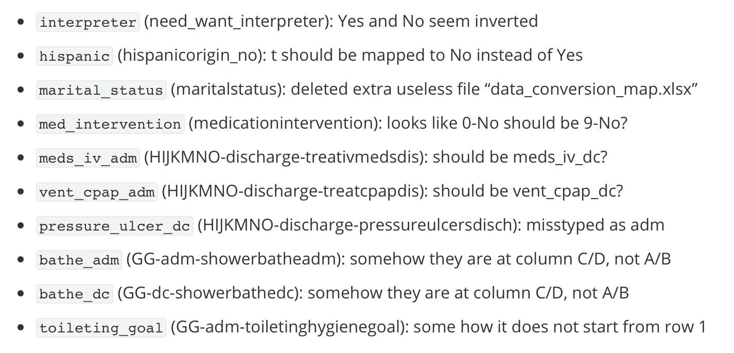
Some corrections to the processing tables

Slide 4
Data preprocessing
maritalstatus -> [Married, Unmarried]
admitclass -> [Initial Rehab, Readmission, Other]
admit_from -> [Home-based, Short-term Hospital, Other Facility]
prehospital_living & discharge_living -> [Home, Facility]
heightinches & weightpounds: records with a 0 value are to be imputed
All treatment amounts (e.g. ptindweek1): drop patients with a total minutes > 600 for any discipline
transport_lack/_med/nonmed/unable/declined: grouped as a single feature transport_lack [Yes, No, Unknown]
language: dichotomized as [English, Non-English]
hispanic/_Mexican/puertorican/cuban/other/unable/declined: grouped as a single feature hispanic [Yes, No]
race -> [White, Black, Alaskan, Asian Indian, East Asian, Southeast Asian, Pacific Islander, Unknown]

Slide 5
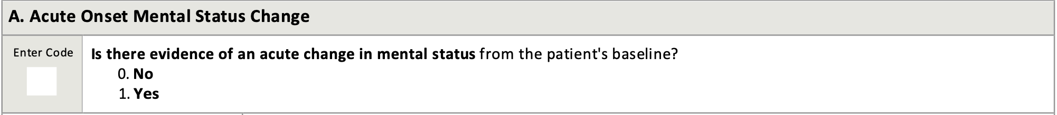
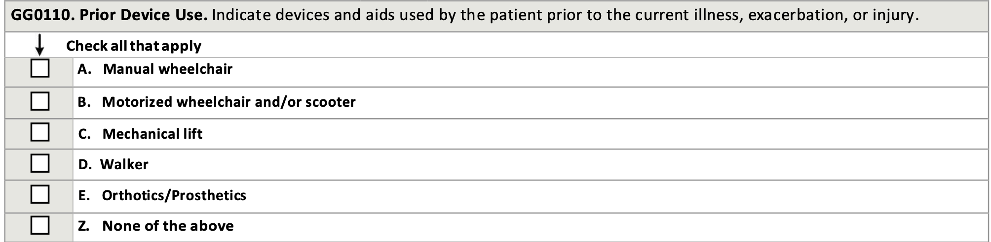
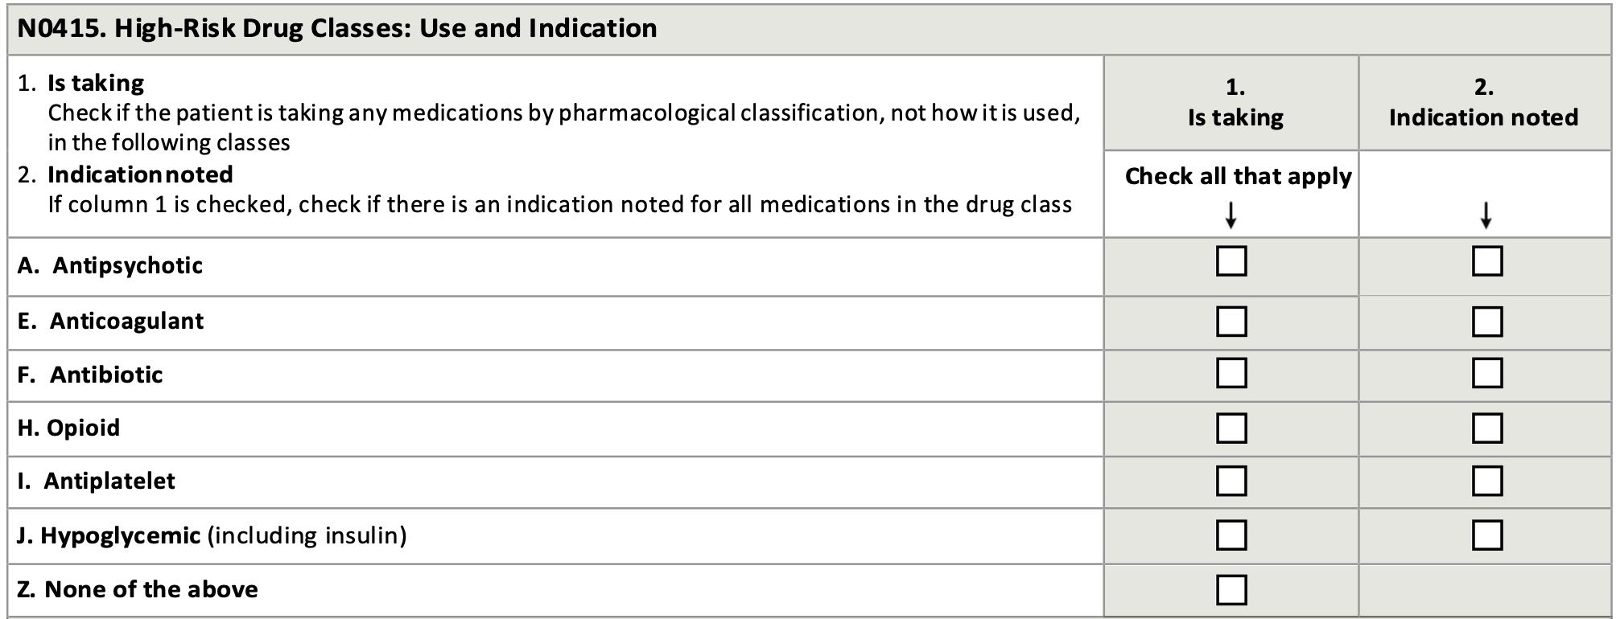
4 types of features
Binary
Including:
“yes or no”
“check all that apply”
Expected format: 0/1
Missing values: must be assigned 0/1 based on some prior assumptions

Slide 6
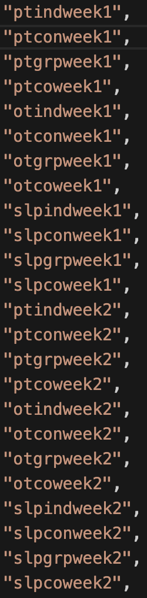
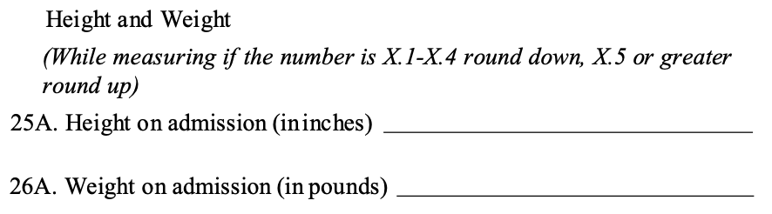
4 types of features
Binary
Numeric
Including:
all continuous numeric fields such as weight and height
treatment doses
Expected format: float64 literal value
Missing values: kept for later imputation

Slide 7
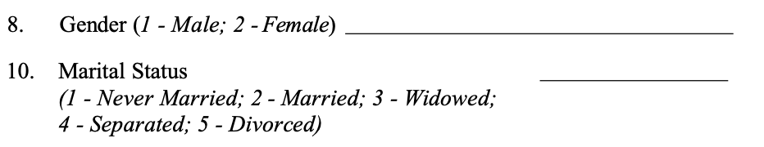
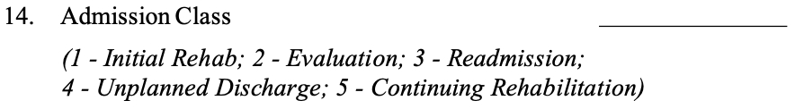
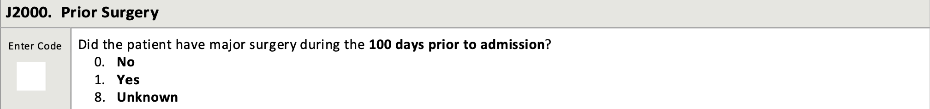
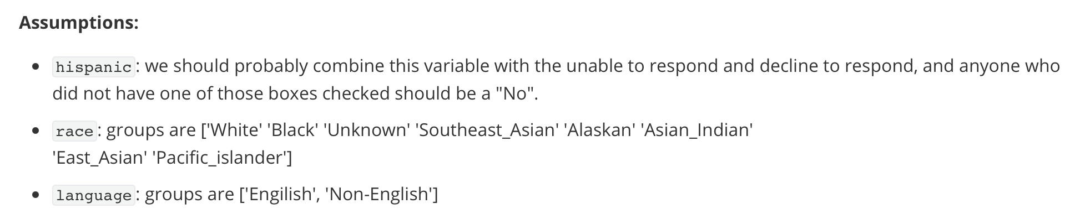
4 types of features
Binary
Numeric
Categorical
Including:
categorized labels (sex, admission unit type, …)
single choice questions with more than 3 possible choices
Expected format: string literal value
Missing values: replaced with “Unknown”

Slide 8
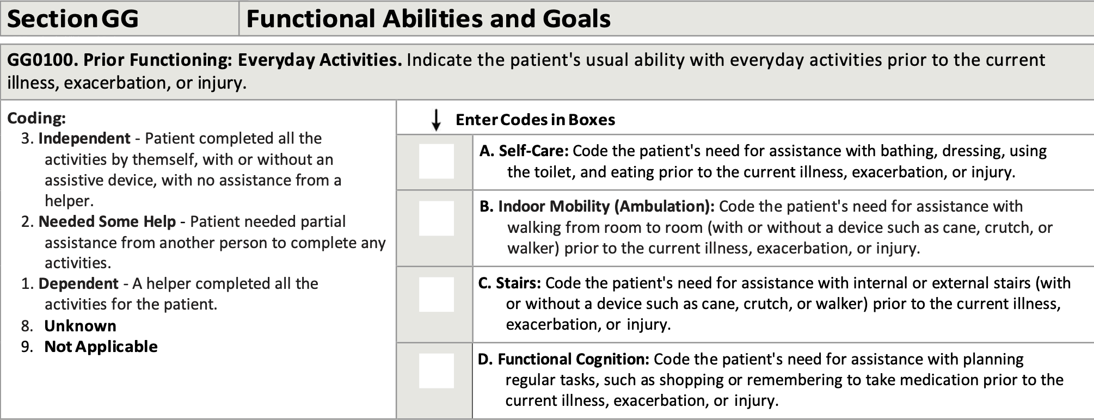
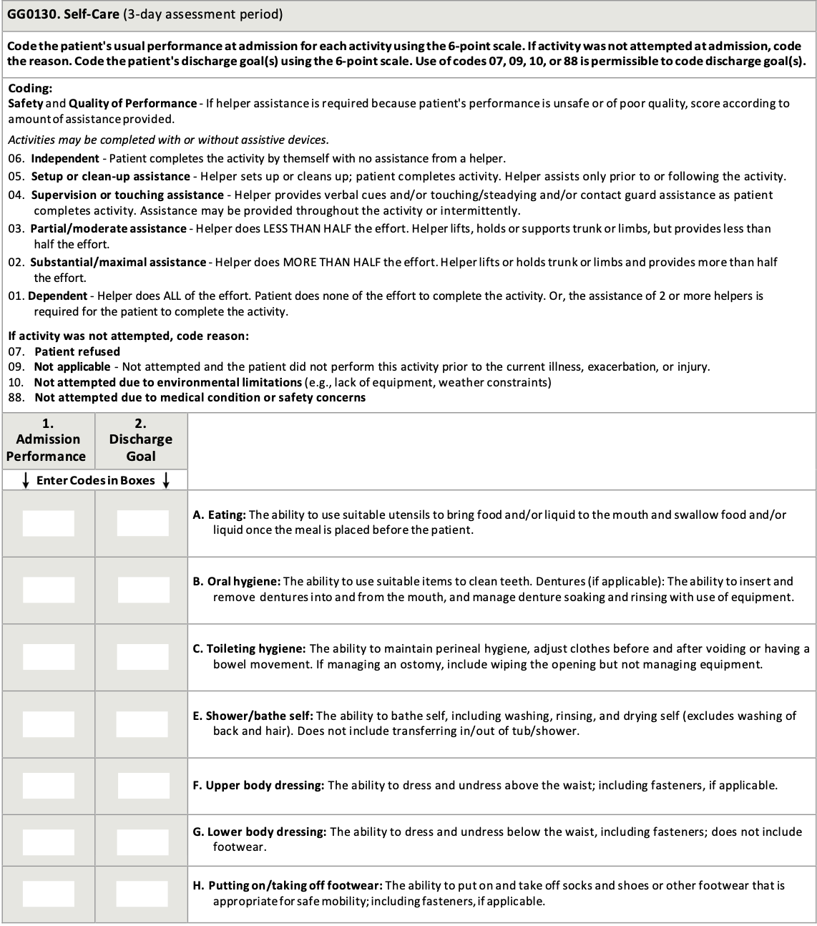
4 types of features
Binary
Numeric
Categorical
Ranked integer
Including:
all integer features with an inherent order, e.g. outcomes
Expected format: int literal value
Missing values: kept for later imputation; for outcome items, replaced with the least ordinal 1

Slide 9
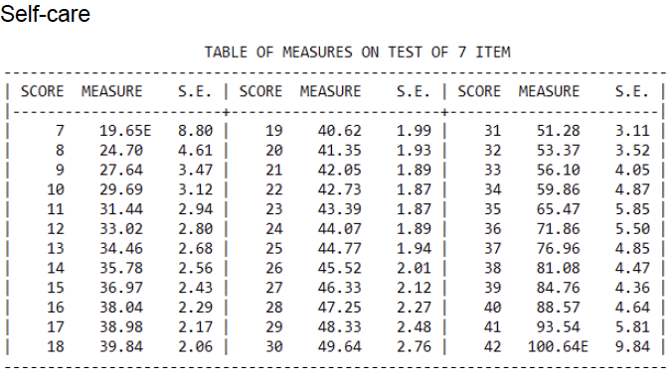
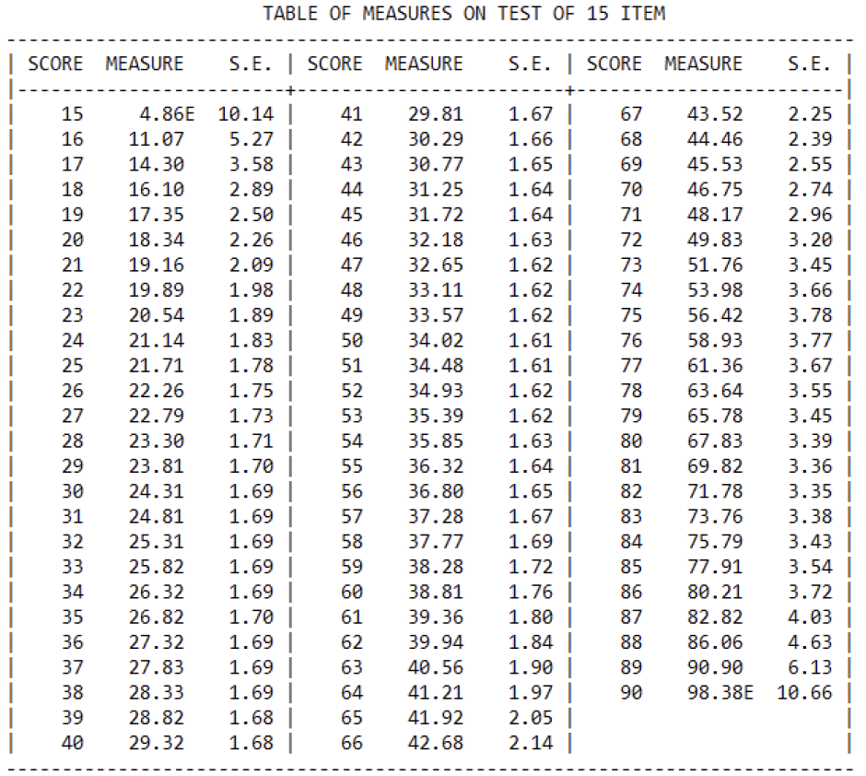
Regression Targets
selfcare_measure_delta
mobility_measure_delta

Slide 10
Outline
Relabeling & Pre-processing
Feature Selection & Post-processing
Interested predictors & outcomes
Imputation
One-hot expansion
Regression
Feature Importance Analysis

Slide 11
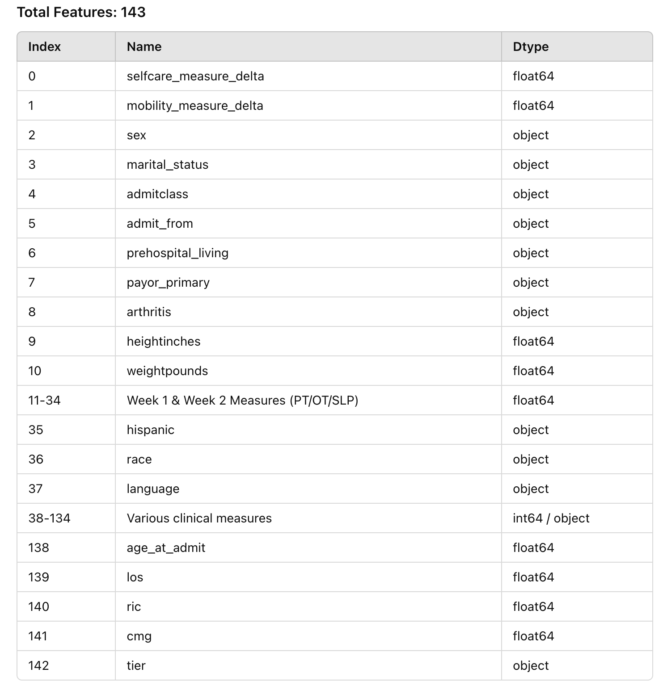
Interested Predictors & Outcomes

Slide 12
Imputation
First, define & fix data splits
Train vs eval vs test = 4:1:1
Default imputation strategy
Binary features: no need for imputation
Numeric features: replace NaNs with the feature’s mean on training set
Categorical features: added extra “Unknown” class, no further need for imputation
Ranked integer features: replace NaNs with the feature’s mode on training set

Slide 13
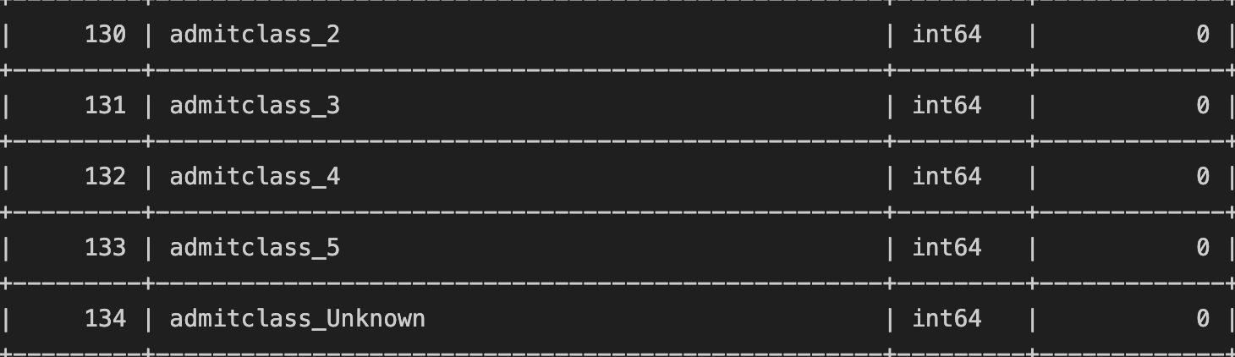
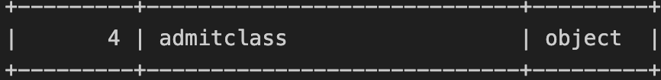
One-hot Expansion
Performed on all categorical features
1 categorical feature with N classes -> N-1 expanded binary features (drop-first)
After expansion, # of features: 142 -> 187
before
after

Slide 14
Outline
Relabeling & Pre-processing
Feature Selection & Post-processing
Regression
Feature Importance Analysis

Slide 15
Recap
185 predictors, 2 targets
selfcare_measure_delta
mobility_measure_delta
Fit the model to training set (2/3)
Linear Regressor
Random Forest
XGBoost
Tune the hyper parameters on evaluation set (1/6)
Test the regressor on test set (1/6), report metrics:
MSE
R²

Slide 16
Results
Metrics | LR (on train set) | LR (on test set) | RF (train) | RF (test) | XGB (train) | XGB (test)
Selfcare MSE | 313.68 | 312.43 | 41.22 | 288.30 | 170.57 | 291.47
Selfcare R² | 31.16% | 30.43% | 90.95% | 35.80% | 62.57% | 35.10%
Mobility MSE | 318.01 | 309.68 | 41.24 | 284.71 | 173.41 | 286.62
Mobility R² | 24.73% | 25.91% | 90.24% | 31.89% | 58.95% | 31.43%

Slide 17
Outline
Relabeling & Pre-processing
Feature Selection & Post-processing
Regression
Feature Importance Analysis

Slide 18
Global summary tree
Method: take RF’s output prediction as target, regress a single decision tree and visualize the tree
Not 100% recovers original RF’s behavior, but pretty close
R²(summary tree’s prediction, RF’s prediction) ~80%
After hyper param search, depth is set to 5

Slide 19
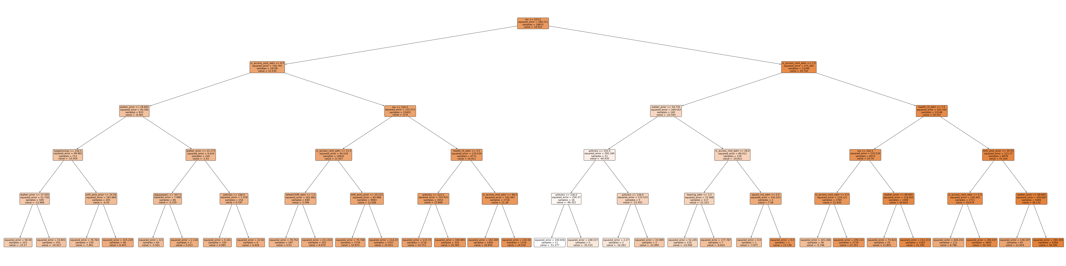
Global summary tree - selfcare

Slide 20
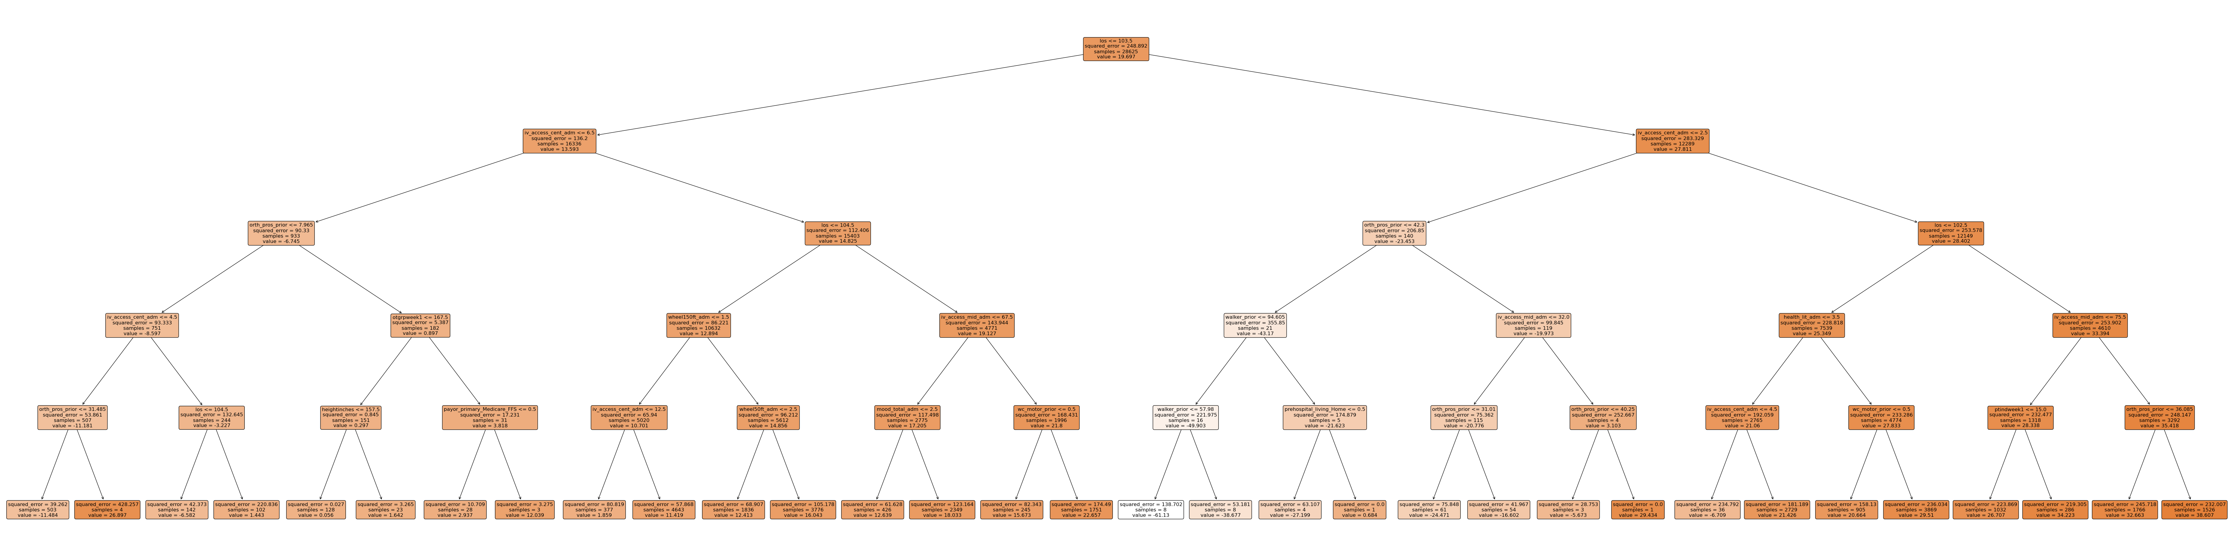
Global summary tree - mobility

Slide 21
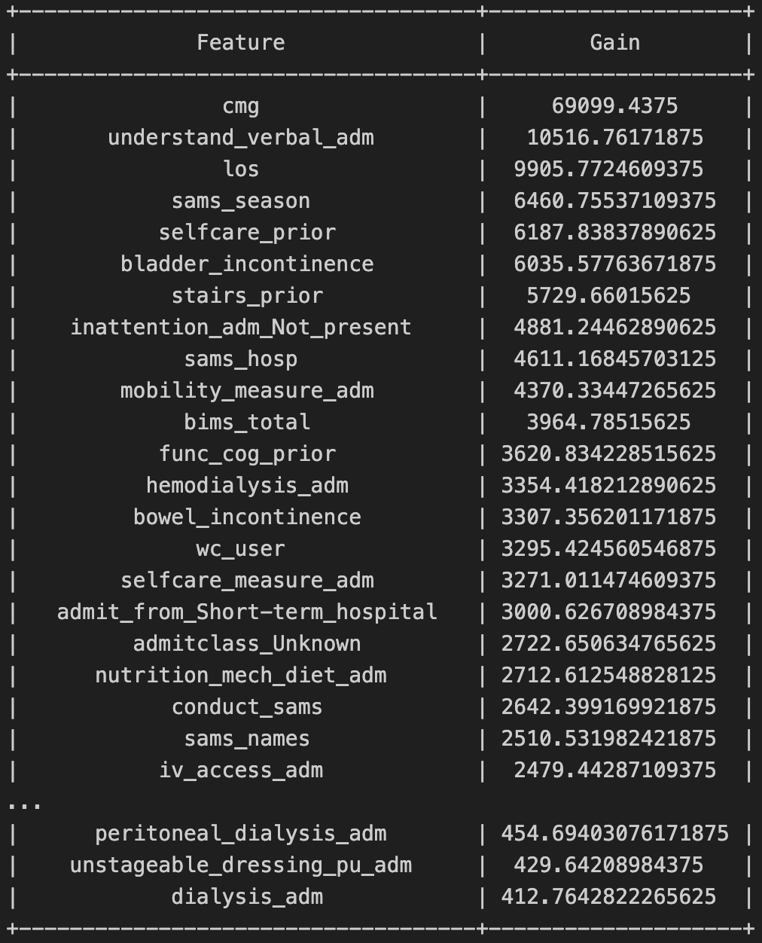
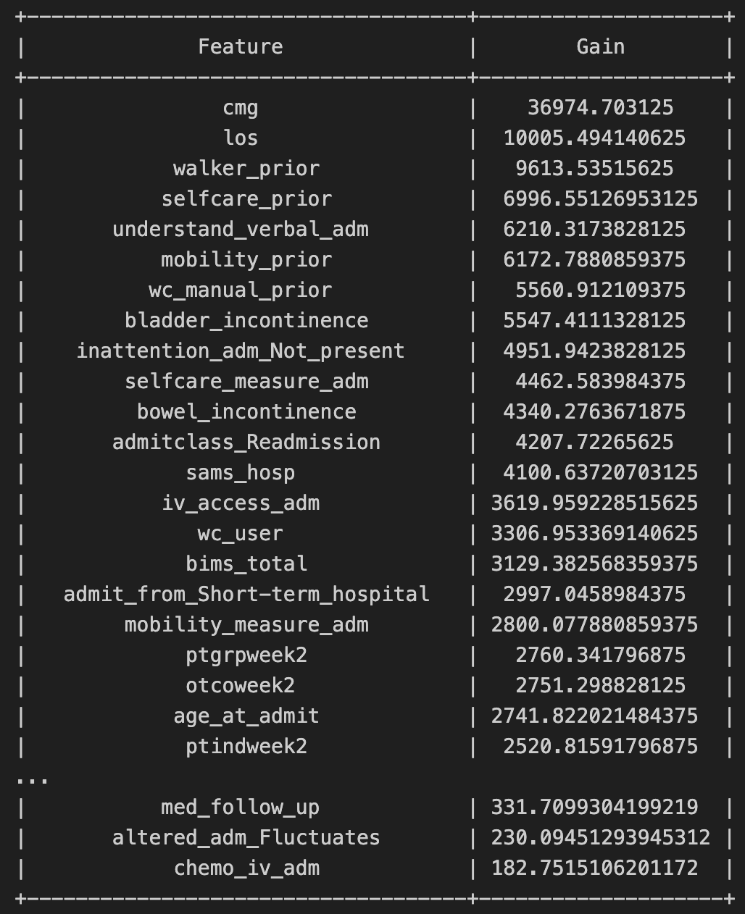
XGBoost - Gain
Measures how much each feature contributes to lowering the global loss
selfcare
mobility

